Slide 1

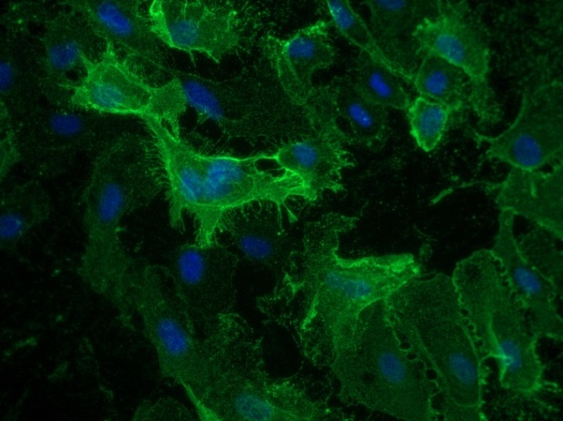
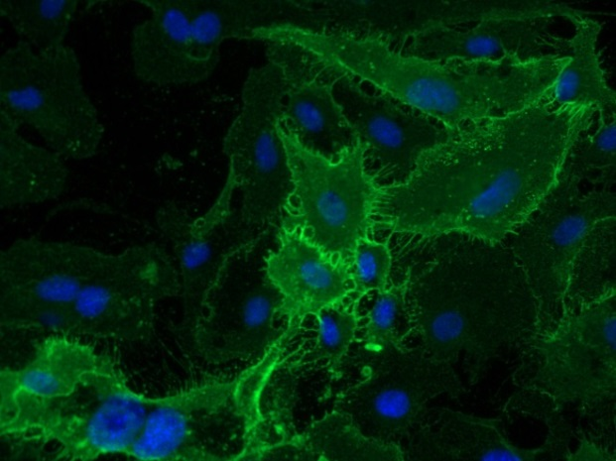
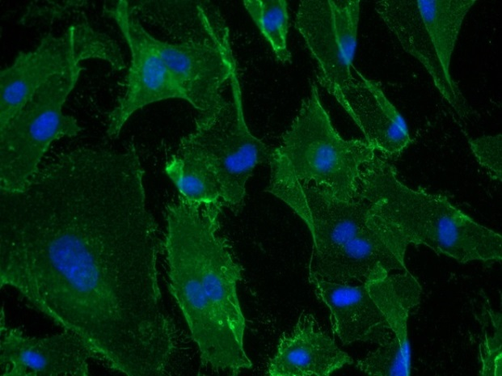
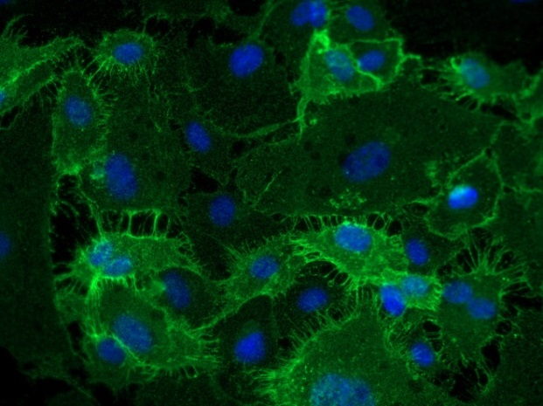
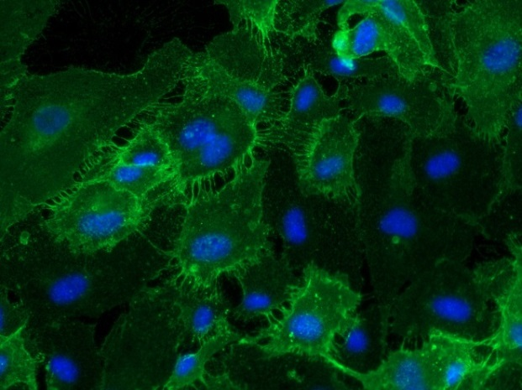
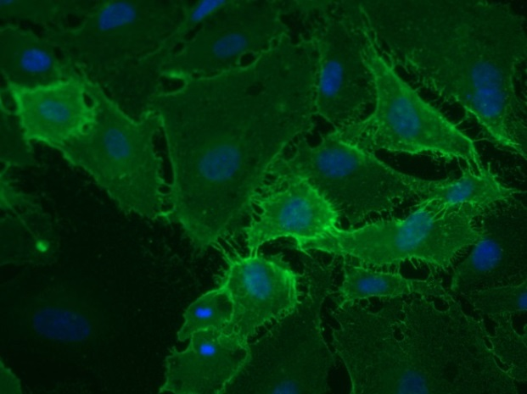
Reliatech GmbH
Mouse anti-human CD31 (#158-2B3)
(Cat #101-M92 / HU1401-01)
1µg/ml
5µg/ml
10µg/ml
1µg/ml (2% BSA)
5µg/ml (2% BSA)
10µg/ml (2% BSA)
Fig. 1: Immunofluorescence staining of human CD31 (red) in HUVEC with and without BSA. Conjugated secondary antibody: goat anti-mouse ALEXA Flour 488 [Dianova]. [IF_HU1401-01]
http://www.reliatech.de / orders@reliatech.de

